Slide 1
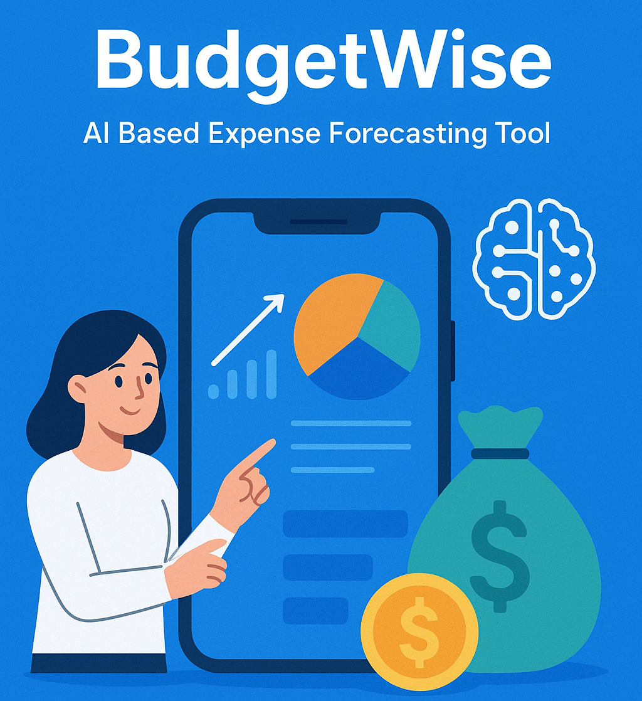
Team-a
Guided by: Sangeetha mam
Done by:
Yeddu divya sri

Slide 2


Abstract: A web-based personal finance management system. Tracks, visualizes, and predicts monthly expenses. Uses Python Flask for backend and CSV for data storage. Machine Learning (Linear Regression) predicts future spending. Helps users make better budgeting decisions. 👤 → 💰 → 📊 → 🤖 → 🎯

Slide 3


Problem Statement: People often struggle to track and manage their daily expenses. Manual tracking is time-consuming and error-prone. No visual insights to understand spending patterns. Users cannot estimate future expenses based on past trends. Lack of automated tools affects budgeting and financial planning. So, to solve these financial struggles, we developed a smart expense tracking and forecasting system that helps users manage their money effortlessly.

Slide 4

Proposed Solution: A web-based expense tracking and forecasting system. Allows users to add, edit, delete, and manage daily spending. Automatically generates visual insights using charts and graphs. Uses Machine Learning to predict next month’s expenses. Provides downloadable reports to support financial decision-making. User-friendly dashboard for quick analysis and monitoring.

Slide 5
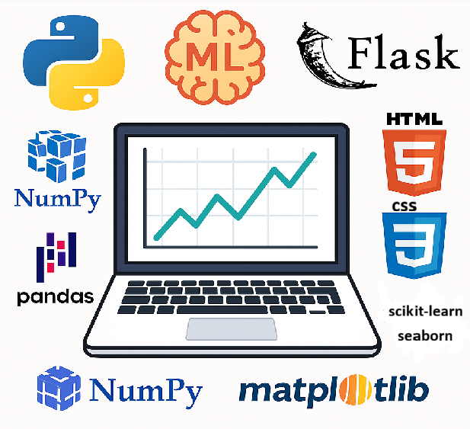
Technologies & Frameworks Used: Python — Core programming language used for backend logic, data analysis, and machine learning. Flask — Lightweight web framework used to build the application interface and handle routing. Pandas — Used for dataset handling, cleaning, grouping, and preprocessing operations. NumPy — Performs numerical computations and supports feature engineering for the ML model. Matplotlib — Generates bar charts, line graphs, and other data visualizations. Seaborn — Creates advanced and visually appealing statistical plots. Scikit-Learn — Used to build, train, and evaluate the Linear Regression machine learning model. HTML/CSS — Used for the front-end structure and styling of the dashboard and forms.

Slide 6
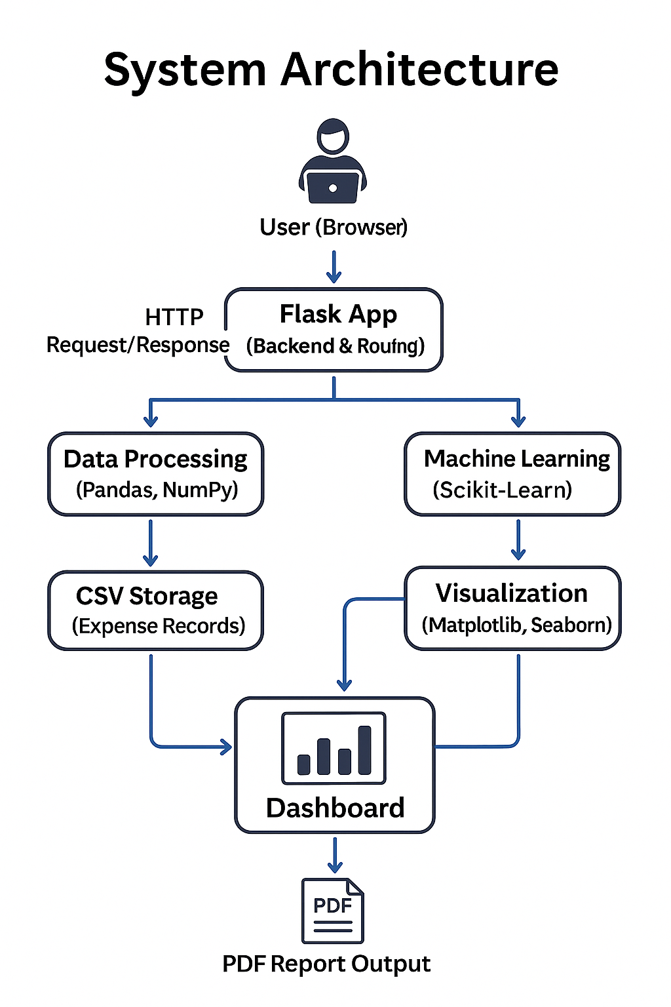
The architecture is based on a simple client–server model using Flask. User inputs are handled through a web interface built with HTML and CSS. Data is stored and managed in a CSV file using Pandas and NumPy. A machine learning model (Scikit-Learn) analyzes past data to predict expenses. Visualizations and reports are generated using Matplotlib and displayed on the dashboard.

Slide 7
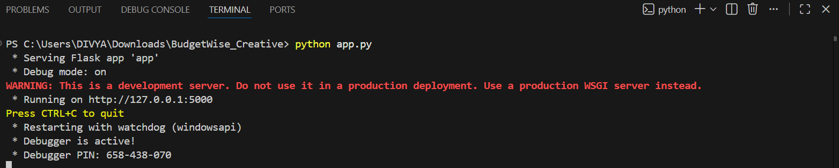
RESULTS AND OUTPUTS:
Step 1: Run python app.py in terminal. And it will generate a link http://127.0.0.1:5000 or type localhost:5000 in browser. Click on that link it will direct into the login form. Step 2: The login form consists of default username : divya and password:1234. And there will be register form for the registration of new user. After the registration we can login and open the home page.

Slide 8
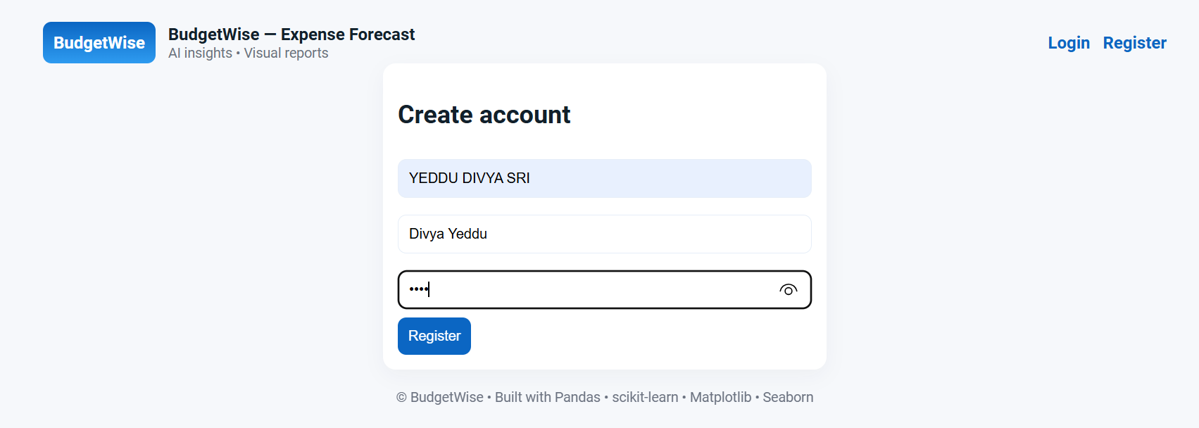
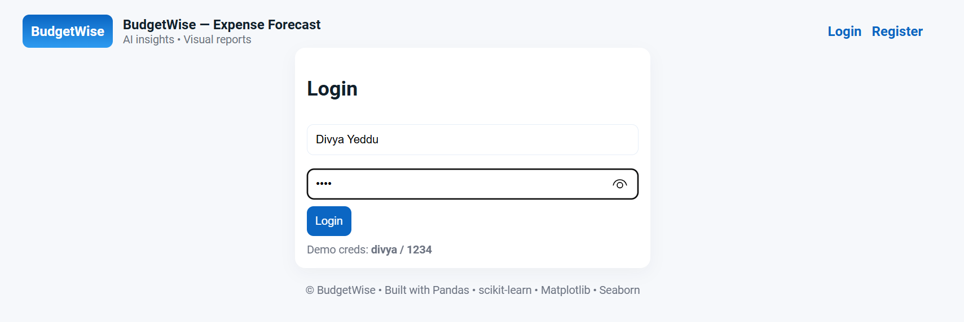
Register Form and Login Form:

Slide 9
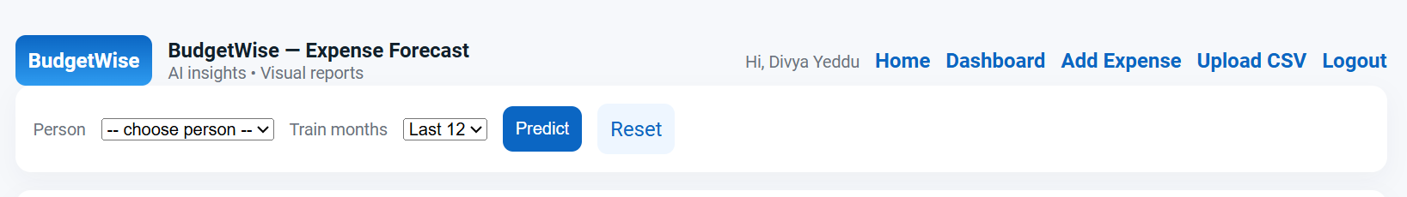
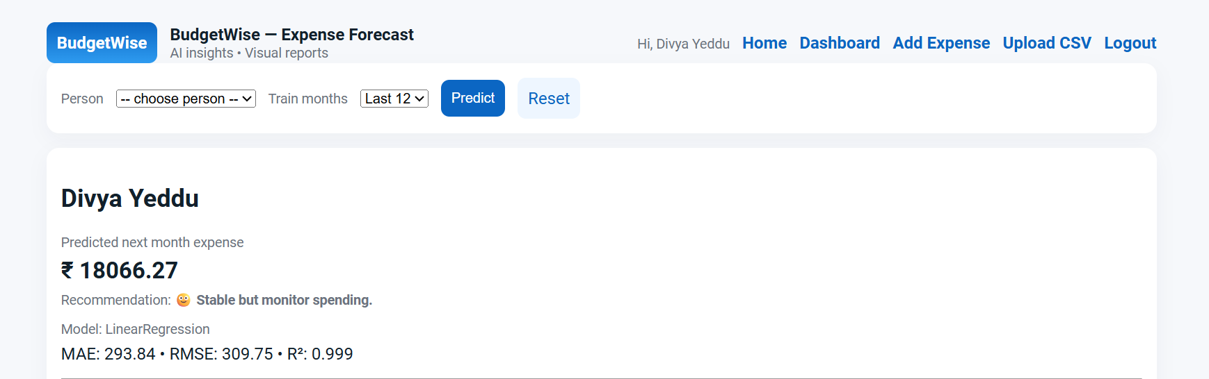
Step 3:It will appear as shown in figure after login. Click the person and select the train months and click predict to see the information and plots..

Slide 10
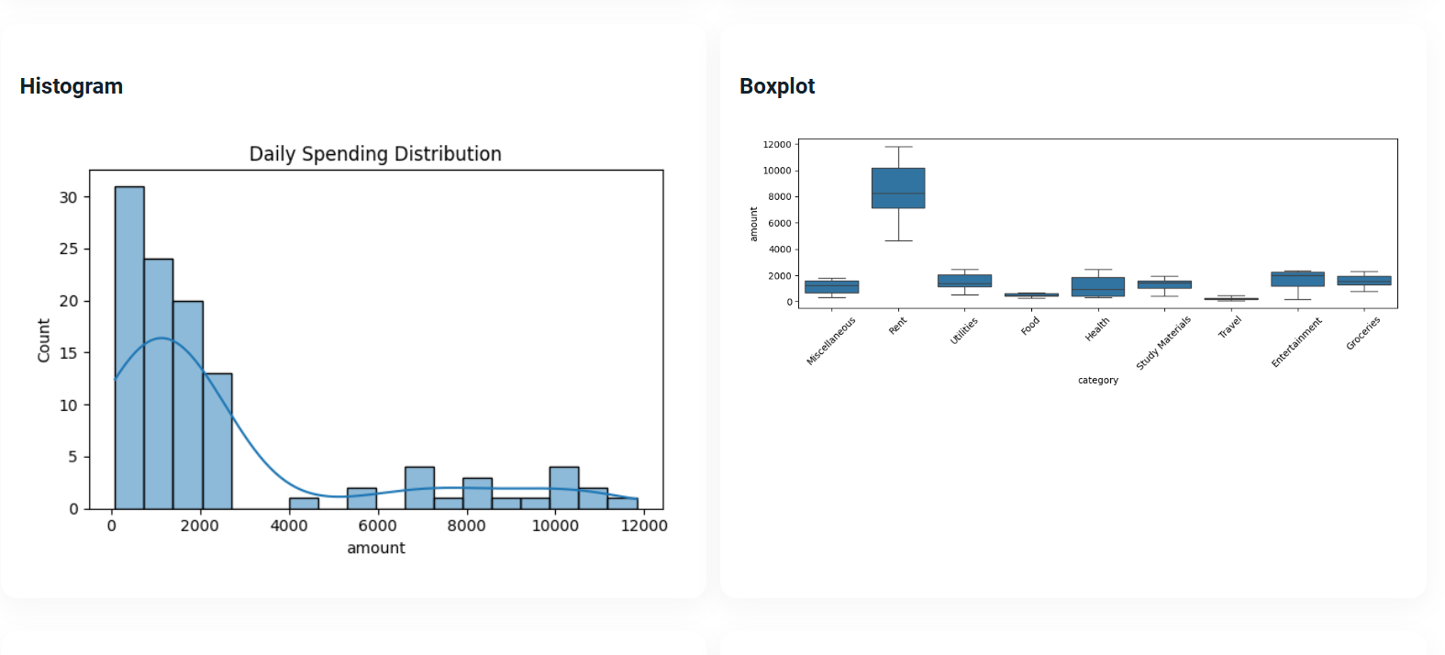
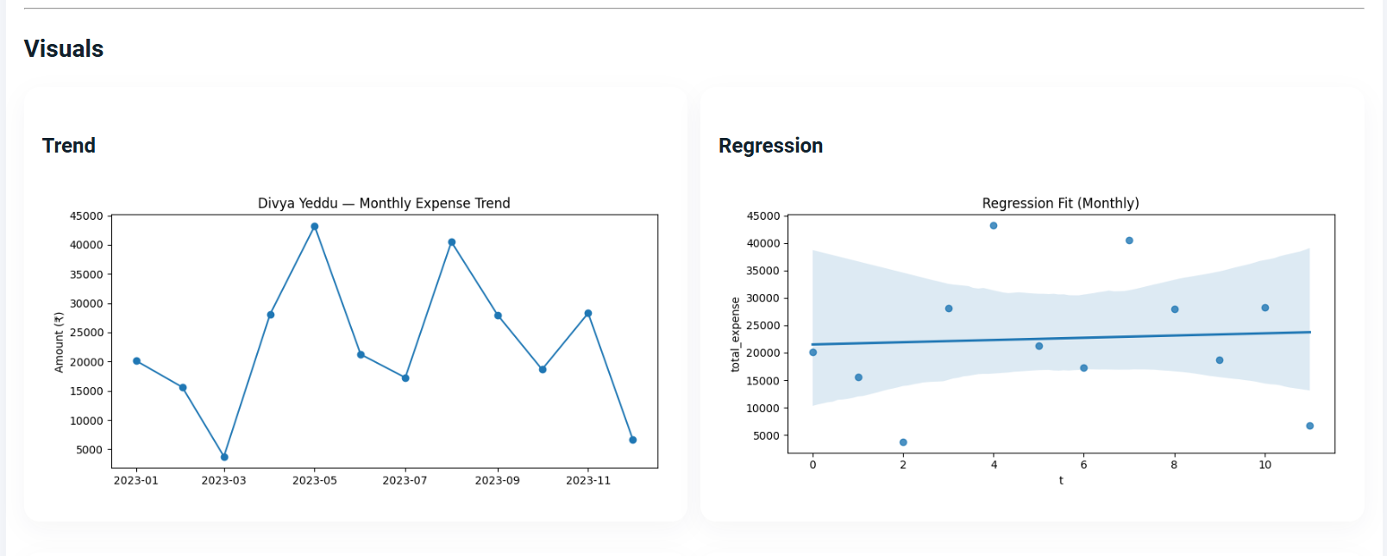
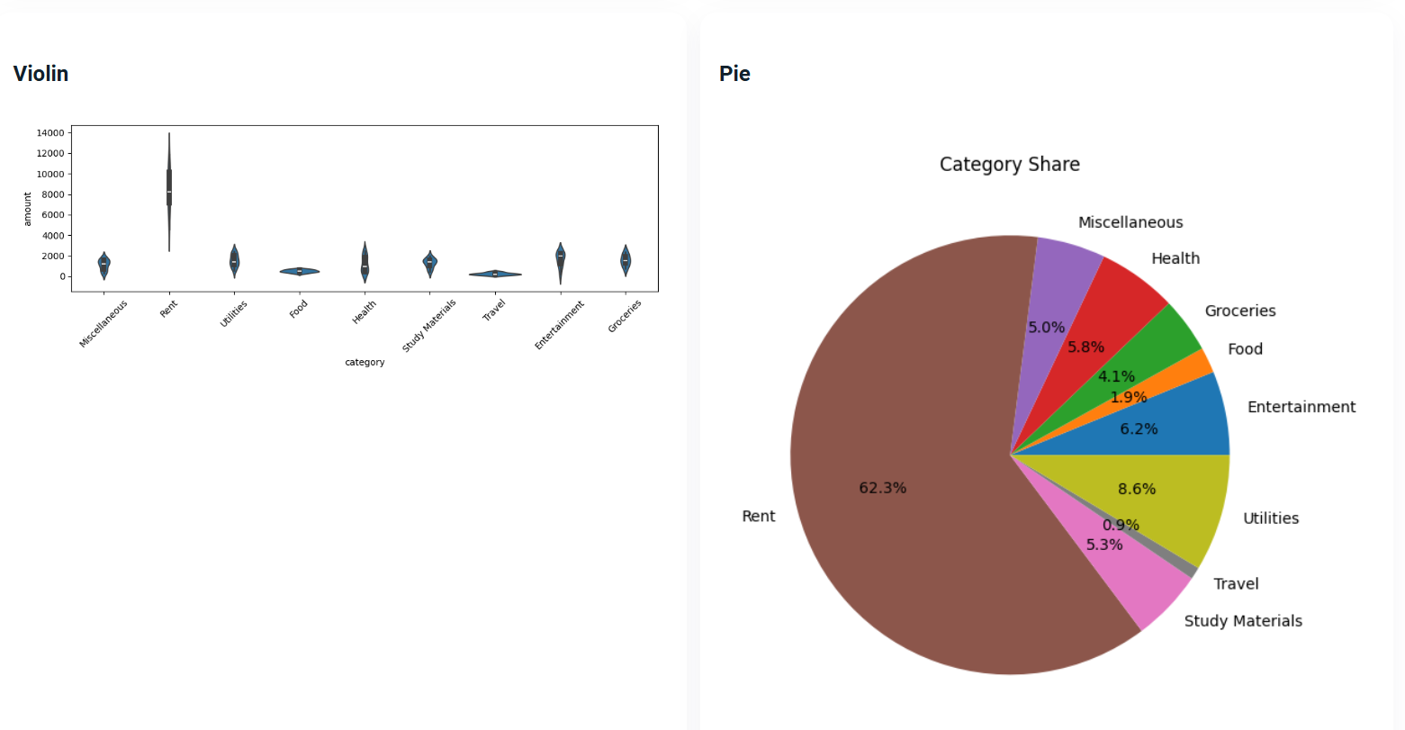
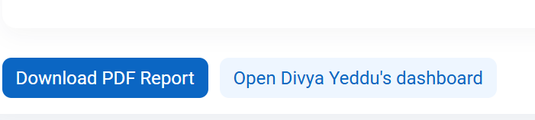
VISUALS OF PLOTS:
Here we can download the report and open the dashboard

Slide 11
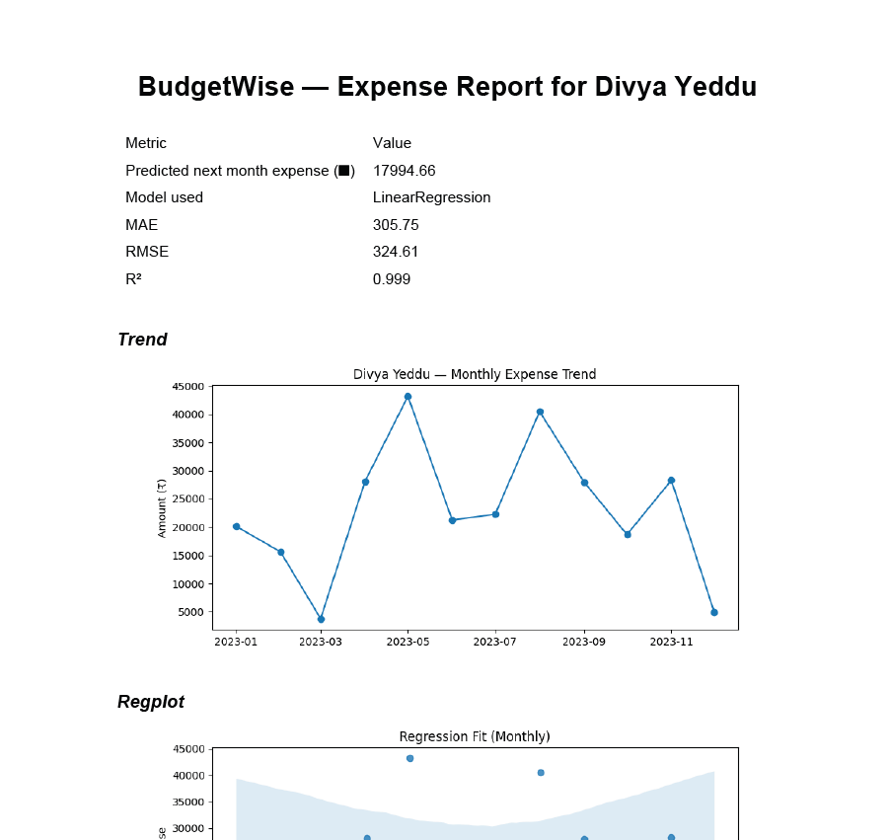
DOWNLOADED REPORT APPERS LIKE THIS:

Slide 12
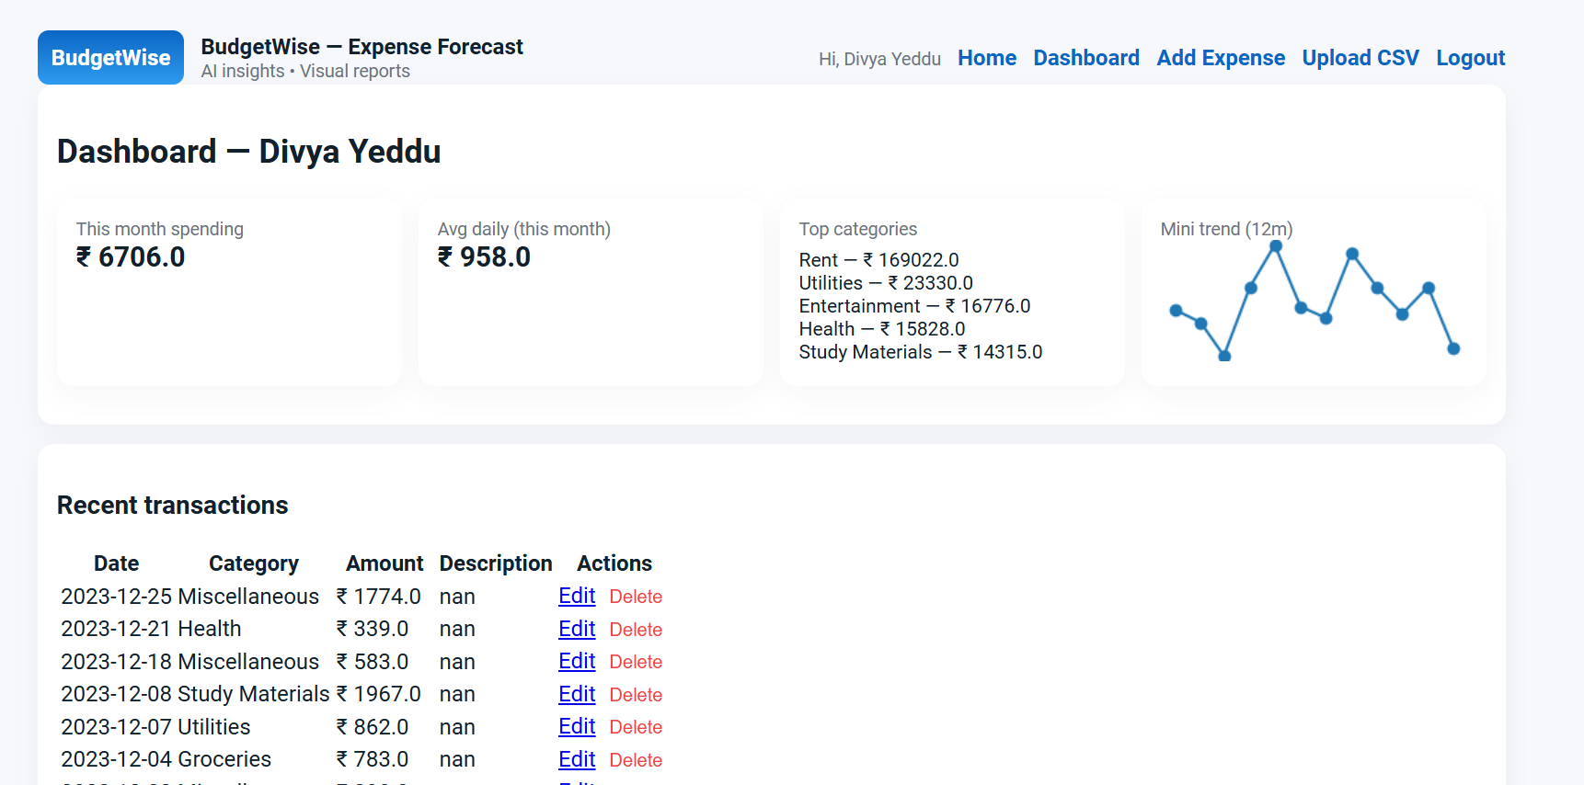
Step 4: Dashboard Overview

Slide 13
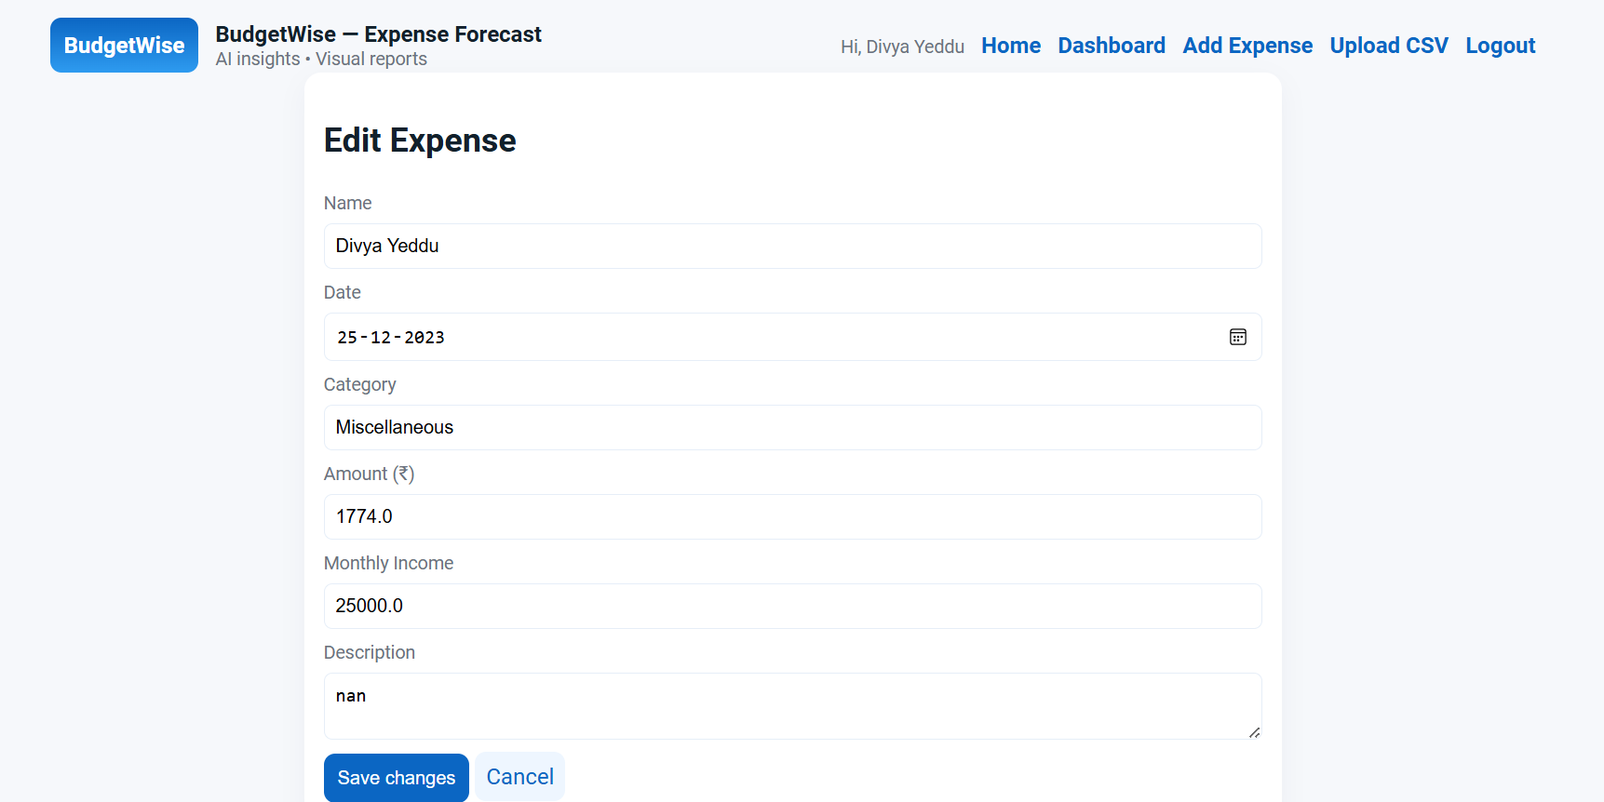
Step 5: Editing the particular Expense from the Transactions

Slide 14
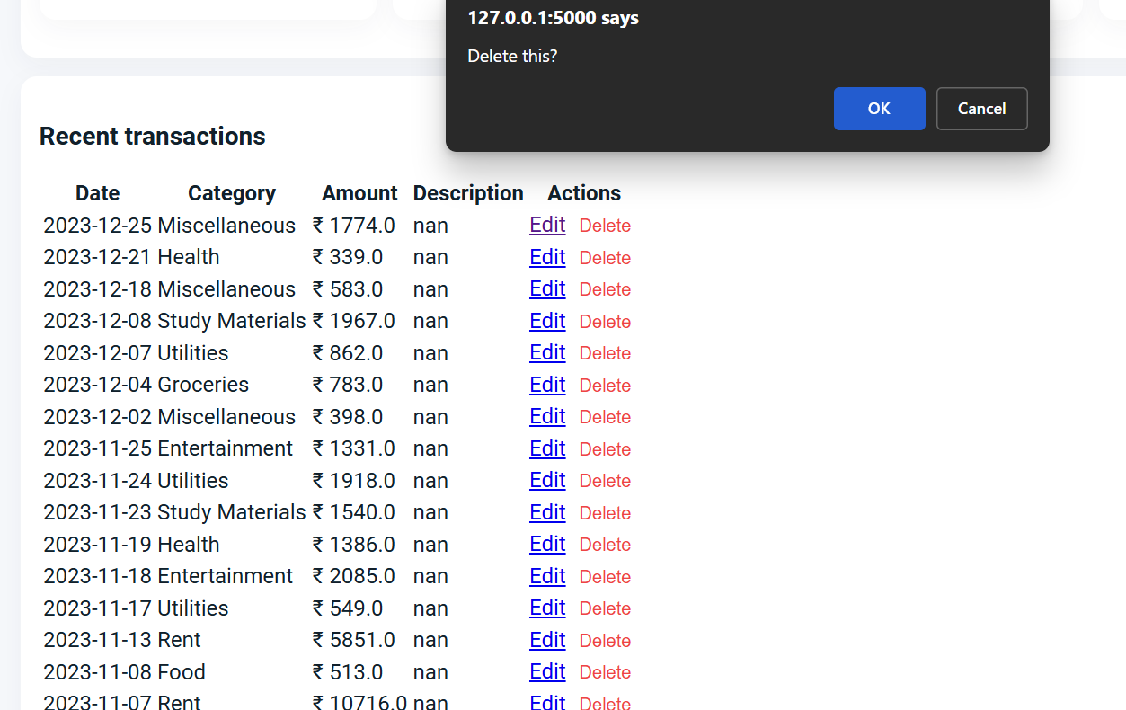
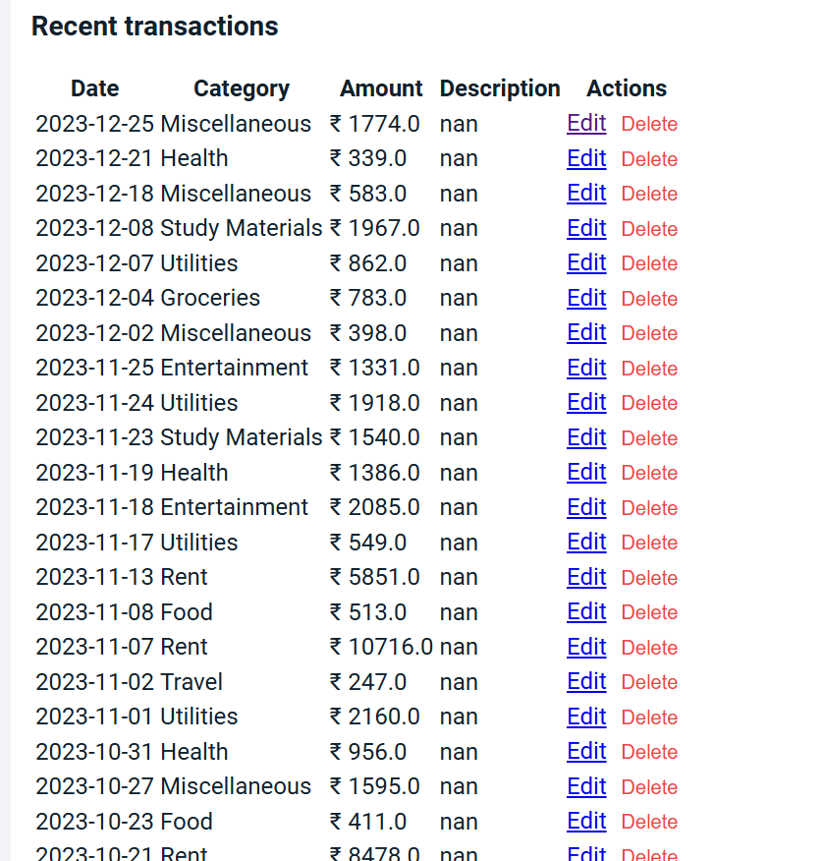
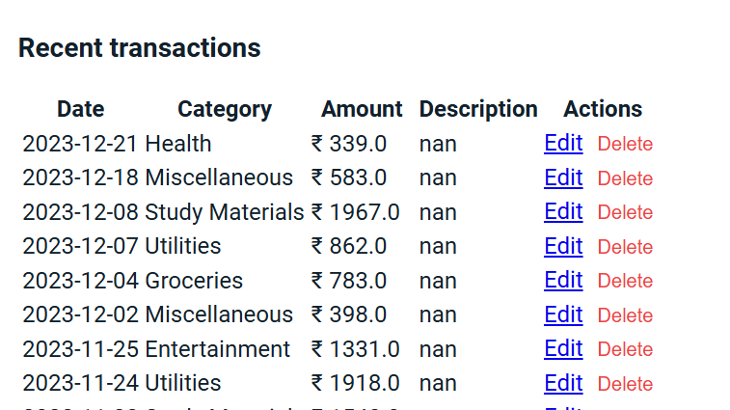
Step 6: Delete the particular transaction

Slide 15
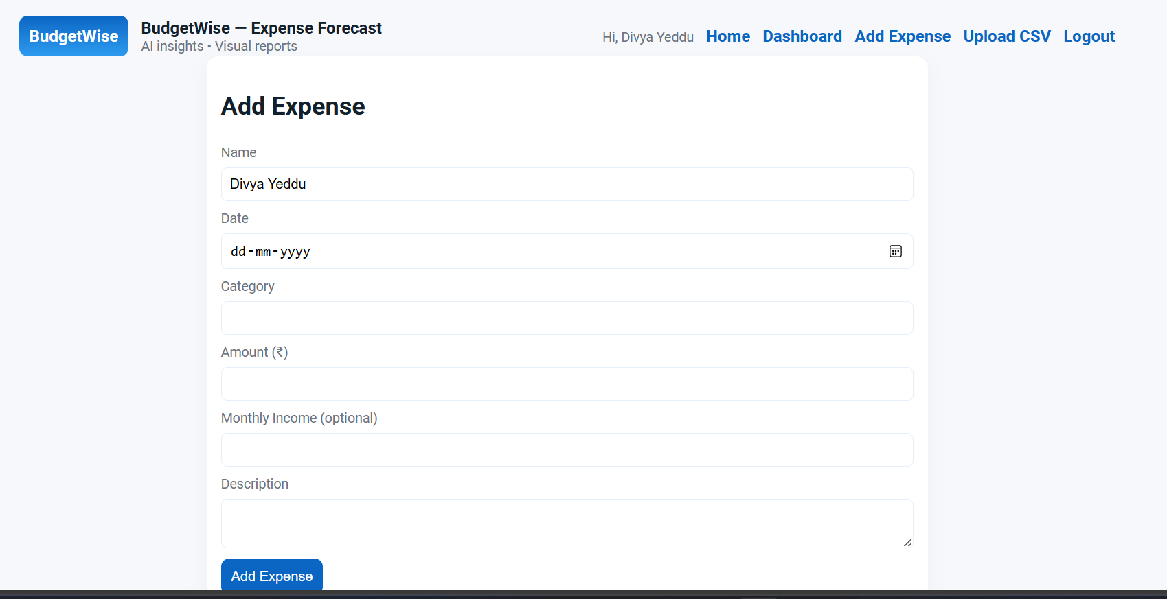
Step 7: Add Expense--- we can add a new transaction.

Slide 16
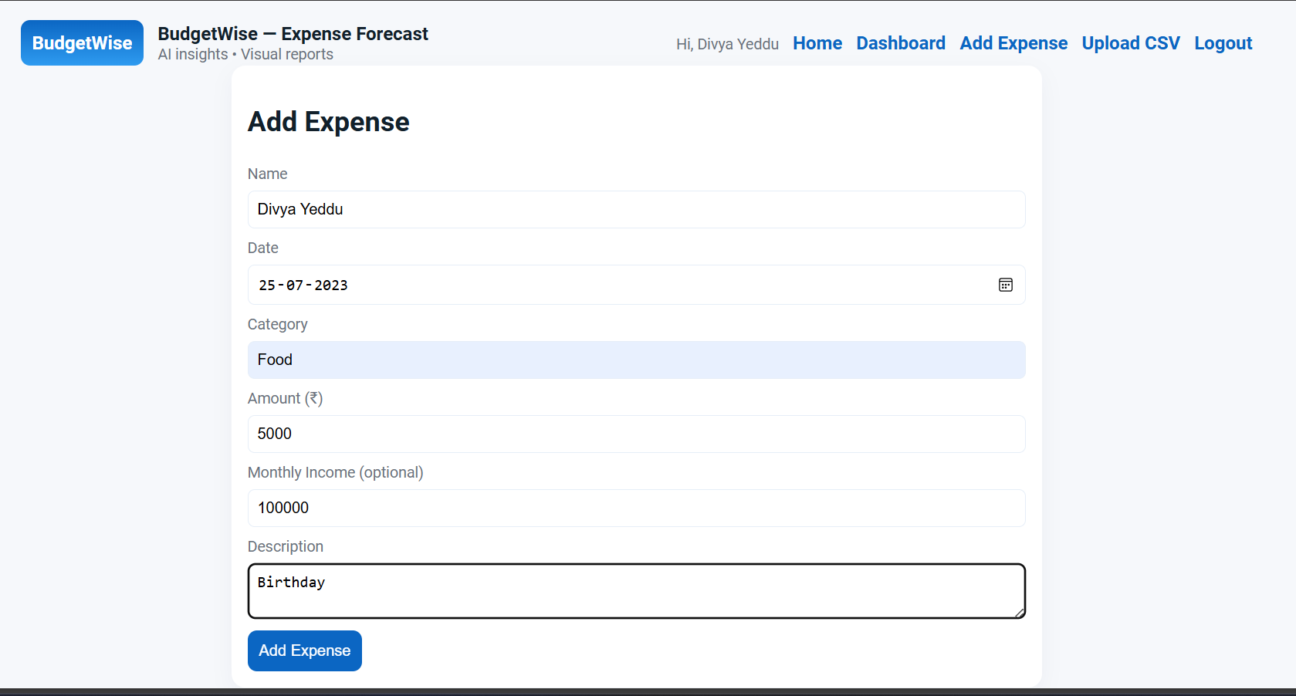
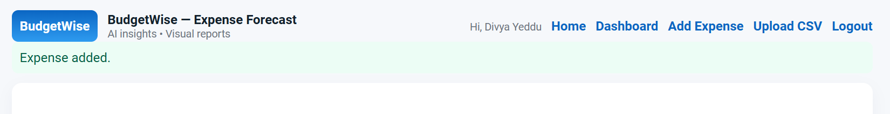

Slide 17
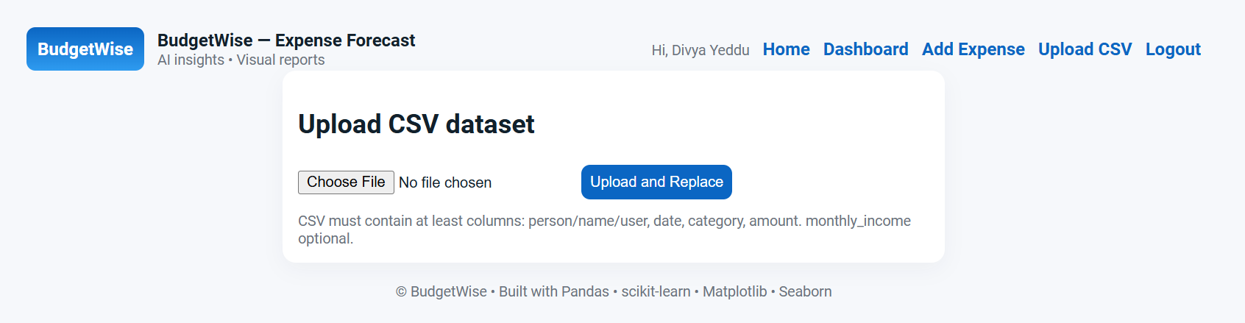
Step 8: Here we can upload the CSV.

Slide 18

Model Evaluation: The model accuracy was measured using standard ML metrics. MAE (Mean Absolute Error): Shows the average difference between actual and predicted values. RMSE (Root Mean Square Error): Measures error while giving more weight to larger mistakes. R² Score (Coefficient of Determination): Indicates how well the model fits the data. Results show the model provides reliable expense predictions.

Slide 19

Advantages: Simple and user-friendly interface suitable for any user. Machine Learning helps predict future expenses accurately. Visual charts make it easy to understand spending patterns. Lightweight system using CSV, no complex database required. Can be easily extended or upgraded with more features in the future.

Slide 20
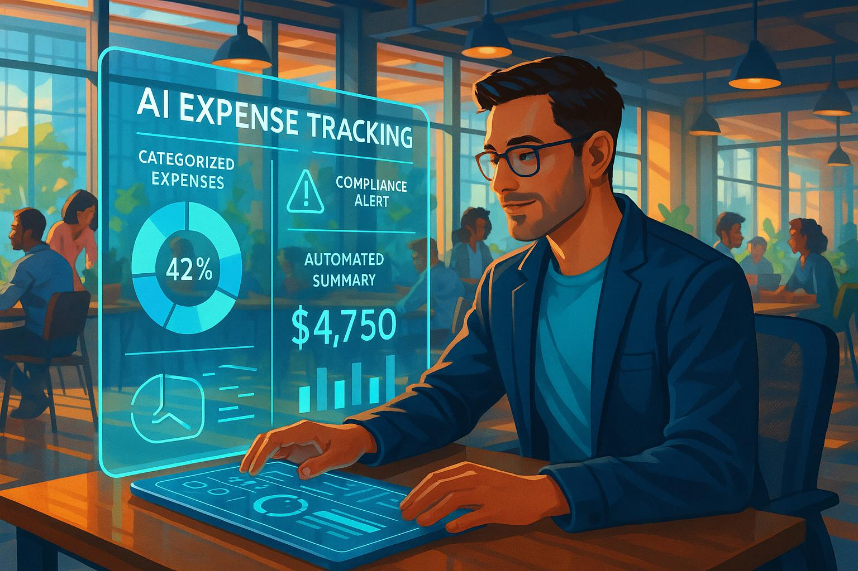
Challenges Faced During Development: Handling CSV data updates without overwriting or losing records. Integrating machine learning prediction with Flask routing. Rendering multiple plots and ensuring they update correctly. Managing errors when users entered invalid or missing input. Fixing UI alignment and ensuring smooth navigation between pages.

Slide 21
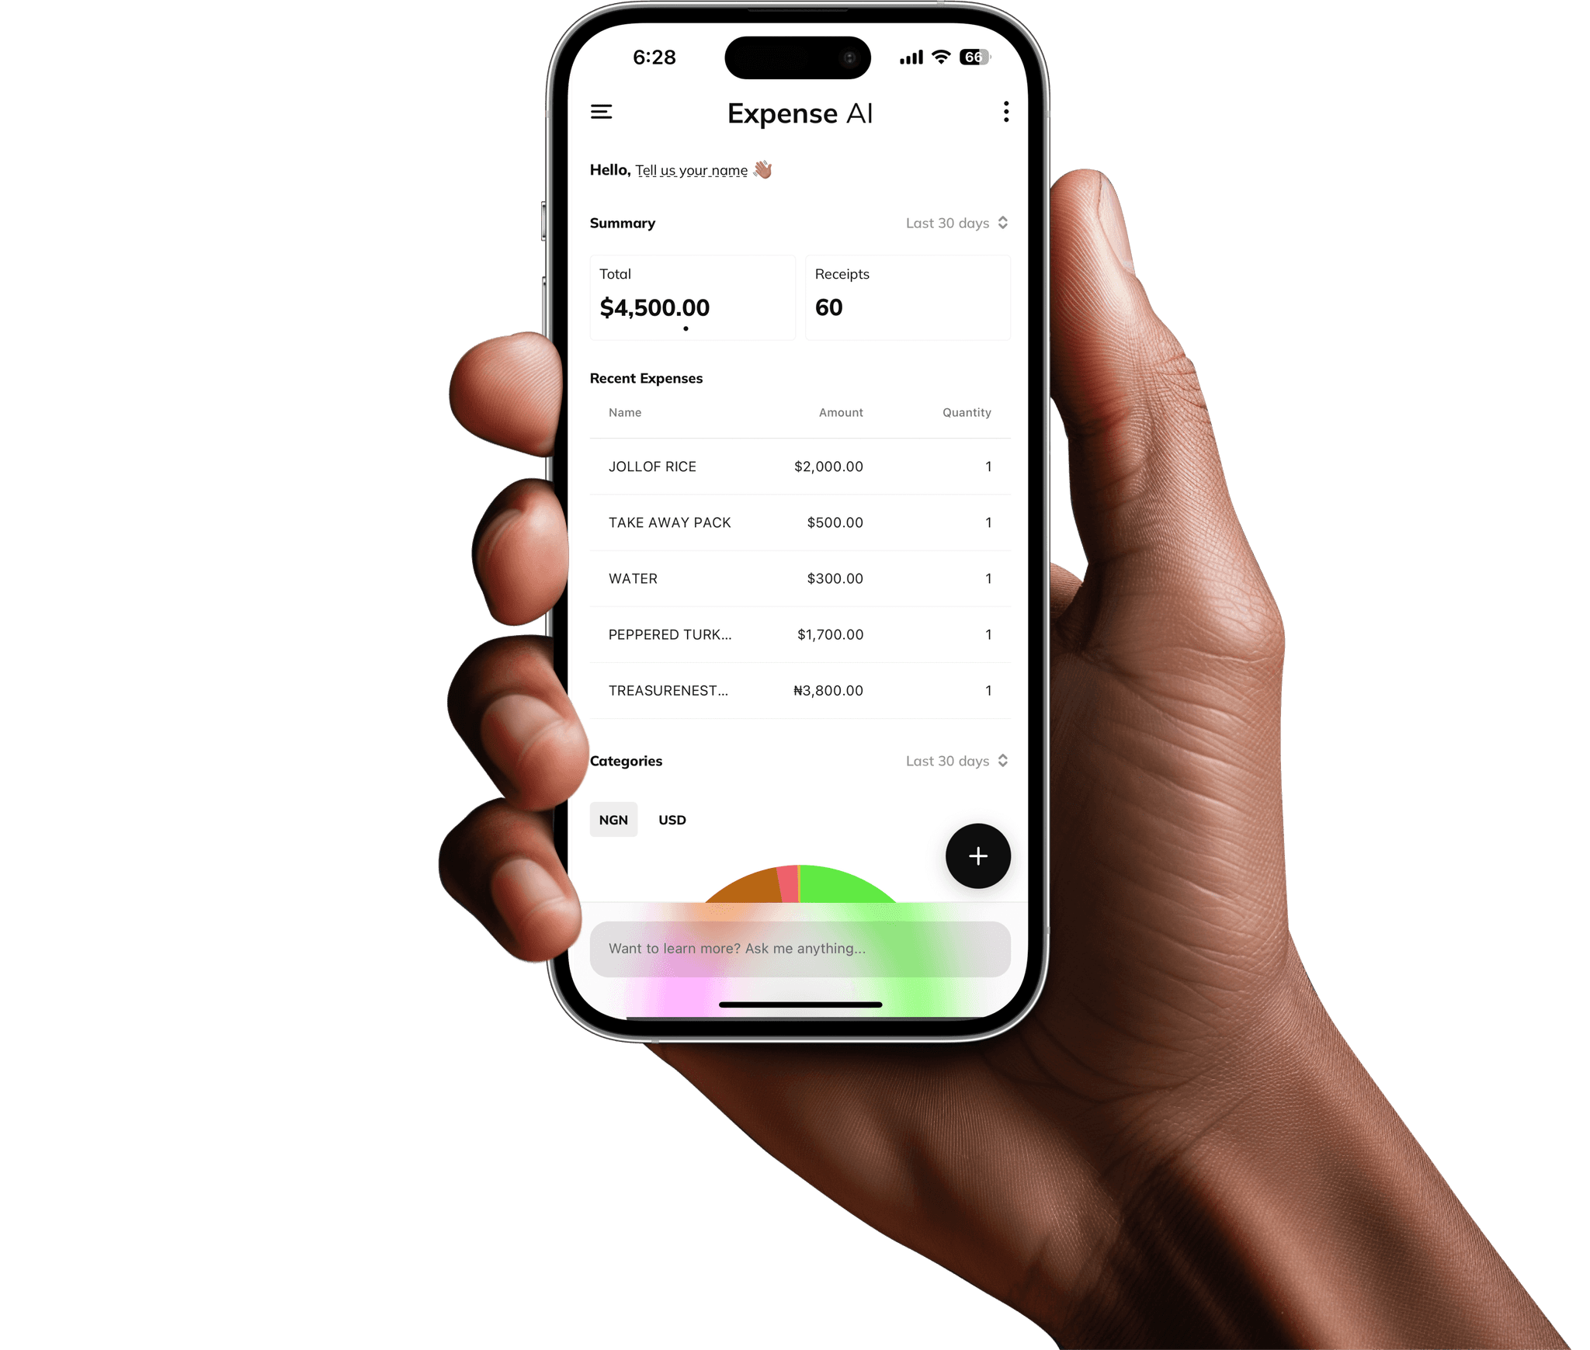
Future Enhancements: Add a mobile app version for easier access on smartphones. Integrate a real database like MySQL or Firebase instead of CSV storage. Use advanced machine learning models like Random Forest or LSTM for better prediction accuracy. Add automatic expense categorization using NLP or OCR for reading bills/receipts. Enable multi-user cloud support with email login and secure authentication.

Slide 22

The system proves that automation and machine learning can simplify financial planning and improve budgeting accuracy.

Slide 23



